Slide 1
Lecture 2 – Arrays
Paula Hannan
hannanp@oit.edu
Last Changed: 1/15/2002

Slide 2
Things I don't want to forget
No Class Next Week
Last Week Review
Lab Yes (Jan 19 1pm) We will cover (In this order):
  C++ file i/o review
  C Vs C++ File i/o
    C file I/O is not a requirement of this class. This review is for your amusement and to help those with a C background.
  C++ file I/O – CST126 Topics
  Lab1 overview, Q&A
  Visual C++ Vs Windows NT Review

Slide 3
Chapter 10 Arrays – Learning Objectives
Be able to use traditional C Strings
  Know the common standard string functions
  Avoid the pitfall
Be able to use the C++ Class string
Be able to use Multidimensional Arrays
Understand how the communicative property effects operator precedence.
Understand how to research / fix differences between compilers

Slide 4
Why?
Why study strings and multidimensional arrays.
  What cool things can you do with strings?
  What cool things can you do with multi-dimensional arrays?

Slide 5
Why?
I think computer animation is really cool.
Consider the animation technique "Motion capture". Models wear special badges that allow cameras to track their motion. How do you think they store the position of the badges when the video is transferred to computer animation?
To learn more:
whyfiles.org/077comp_anim/index.html

Slide 6
Traditional C Strings
Aka CSTRINGS
Arrays of character. IE char name[30].
Terminated with '\0'. (Leave room for '\0').
Can't use =, ==, < or > etc. with cstrings.
Special functions (in <CSTRING>)

Slide 7
CSTRING Basics
Remember arrays use 0 -> size-1
We need maximum string + 1 to include '\0'
Consider char s[11] = "Blue Moon";
s[0] s[1] s[2] s[3] s[4] s[5] s[6] s[7] s[8] s[9] s[10]
B l u e M o o n '\0' ?
The equals here is initialize NOT assignment. You can NOT say:
  char s[11];
  s = "Blue Moon";

Slide 8
Miscellaneous CSTRINGS
CSTRINGS are arrays
  They pass into functions the same as other arrays.
  You can loop through them with a for
They can use standard cin / cout... remember though, cin doesn't handle spaces well.
  Use cin.getln to get a whole string with spaces. (Textbook Page 621)
  Review at your leisure Display 10.4

Slide 9
PITFALL
Do NOT assume you can use normal operators with cstrings.
==, = (assignment), + , > etc. don't work.

Slide 10
Special functions in <CSTRING>
Turn to your text book page 613
WARNING! WARNING!
One of the most common C errors is to OVERFLOW a cstring.
Check out the textbooks wrapper function for strcpy page 618

Slide 11
Conversion Functions
'1', “1” and 1 are different.
To convert strings to numbers use the atoi, atol and atof functions. (a-tui, a-to-l, a-to-f)
These functions return 0 if not an appropriate number.
IE
  int j;
  char j_char = "99";
  j = atoi(j_char);

Slide 12
More Conversion Functions
You can find out the ASCII value for a character using the following code:
  int ascii;
  char x = 'b';
  ascii = x;
  // note the assignment above IS ok.
  // x is a char not a char []

Slide 13
Hands-On
We are going to figure out hands-on what happens to the '\0' with each of the c-string functions.
Open str.cpp

Slide 14
Sample Program- igpay.cpp
igpay.cpp is a version of programming assignment 14 on page 675.
Complete the "STUDENT TASK"
  Complete the SimpleIgpayAtinlay function first and make sure it works before continuing.
  Notice how I put stub code in the IgpayAtinlay function so that it will at least give a value while you work on SimpleIgpayAtinlay.
  Notice the <cstring> include

Slide 15
The C++ Alternative, class string
In include <string>
Safer then cstring... overflows handled better.
Can use =, + etc...
>> behaves slightly better... leading space is removed.
Two types of string classes: string and wstring.
  Wstring stands for wide-string. It has bigger character sizes to accommodate unicode or other non-latin characters. (ie Kanji, Russian)

Slide 16
C++ string Class
There are loads of different constructors. Here are a few:
  string::string(char *);
  string::string(string & str);
  string::string(size_type num, char c);
IE
  string::string p("Paula");
  string::string q(p);
  string::string z(5,'Z');

Slide 17
String Object Member Functions
Lets all turn to page 650.
  What is the equivalent to:
    strcpy?
    strcat?
    strncat?
  What can you do instead of pointer arithmetic?

Slide 18
String Object Member Functions
The variable string::npos means "end of string"
When a find isn't successful it returns string::npos.
When using find functions always use a return variable of type string::sizetype. Ie:
  string::sizetype idx;
  idx = str.find('.');
So that you can compare:
  if (idx == string::npos)

Slide 19
C++ string Class
With C++ String objects, most of the time a '\0' has NO special meaning . IE:
  char c[5] = {'\0','\0','\0','\0','\0'};
  std::string s(5,'\0');
  cout << s.length(); // outputs 5
  cout << strlen(c); // outputs 0
The only time it maters is when you initialize with a c-string. IE
  std::string s2(c);
  cout << s2.length(); // outputs 0
  cout << strlen(c); // outputs 0

Slide 20
String Object Hands On
Convert your Pig Latin program to strings. Hints:
Check the include directives
Is passing an array in a function close to call by value or call by reference?
There are 3 possible ways to remove the first character:
    pig.erase(0,1); //#1
    pig.delete(0,1);//#2 didn't work w/ Borland
    // #3
    string::size_type size = word.size();
    pig = word.substr(1,size-1);

Slide 21
Pitfall – Operator Precedence and the Commutative property
Remember in math some operators are commutative... the order of the operands doesn't matter. IE a + b = b + a
When only one commutative operator is involved, C++ lets the compiler reorder the operands regardless of parens.
Consider c = a * b * c; The compiler can chose between options like:
        c = b * c * a;
        c = a * b * c;

Slide 22
Operator Precedence and the Commutative property
Consider
i++ * j++ * k++
The compiler has a choice with the three ++ since * is commutative. We don't know which one goes first. Or consider:
i++ + j++ * k++
Again we can't say whether j or k is incremented first

Slide 23
Operator Precedence and the Commutative property
Now consider
i++ * j * i;
Hum... what is the value stored in the second i?

Slide 24
Operator precedence and the Commutative property
Similarly
cout << i << " blah " << i++;
might not do what you expect.
So... Don't code stuff that depends on what order a commutative operator is evaluated.
The example on page 912 of left to right evaluation is a bad. Better would be:
    sales.date.day;

Slide 25
Operator Precedence
If you try to think to deeply about this it will blow your mind... or at least it did mine. The two things I want you to remember are:
  The compiler has the choice of the order it evaluates the operands of a commutative operator.
  Don't do it – Don't write code that relies on the order your compiler evaluates commutative operators.

Slide 26
Differences between Compilers
The standard for C++ is set by ansii
Standards are set every 8 years.
You get 8 years warning about language elements that are "obsolete".
Different compiler programmers make different decisions about how closely they want to meet the standard.
Compile your program on different compilers or more often different OS's is called porting.

Slide 27
Porting – 2
Many of you are familiar with porting because I create the sample programs / hands on at home with a Borland C++ compiler.
I compile and run the samples at home, bring them to school and phhtt... they don't work.
I'm starting to get a handle on the differences and I want you to learn about them too... just in case I miss one. SO,
Bring up ilovems.cpp.
  Examine the differences, compile and run it.

Slide 28
Porting – 3
Look at the ios::nocreate example
  Look up ios::nocreate in the Microsoft help text.
  Look up ios::nocreate in yahoo.
This is an example of an obsolete language element. Compiler programmers try to get a jump on the language by using drafts of the standards. Then if the element doesn't make it in, they have a decision to make.

Slide 29
Multi-Dimensional Arrays
Turn to Page 628
For example:
  int student_ids[15][9]
  15 is the maximum number of students
  9 is big enough to store each SSN
You can think of it as an array of arrays.

Slide 30
Student Grades Example
Display 10.6
Three arrays
  int grade[4][3];
  double quiz_ave[3];
  double st_ave[4];
In Display 10.7 what is the value of grade[3][2]? Grade[0][0]?
Review 10.5 at your leisure

Slide 31
Examples:
How would you pass in an multi-dimensional array element into a function? For example you have:
  void pasta(int count);
  int s_count[10][100];
How do you pass in the count in element 5,25?

Slide 32
Function Calls
The syntax for a prototype that takes an array is:
  type func_name(array_type array[][SIZE2])
Remember the size in the first [] is a comment.
The second and subsequent array dimensions must be specified. For example:
  int cube[10][10][10];
  display_cube(int c[][10][10]);
Of course, its a good idea to pass in the size of the first dimension.

Slide 33
Arrays of cstrings
For example:
  char student_names[15][20]
Display 10.8 - page 636
What would the third name be if I did the following?
  strcat(name[2],"-eggs");
How about #4 if I said:
  name[3][4] = 'a';

Slide 34
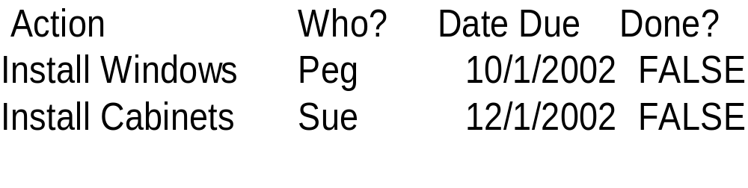
Multi-Dimensional Arrays Vs Arrays of Structures
If we have a variety of types in our information then we want to do an array of structures:
For example if I wanted to create an array for a to-do list that looked something like:

Slide 35
Multi-Dimensional Arrays Vs Arrays of Structures
I would want something like
  ToDo {
    string action;
    string person;
    Date date;
    bool done;
  };
  ToDo house[100];
  house[0].action = "Install Windows";

Slide 36
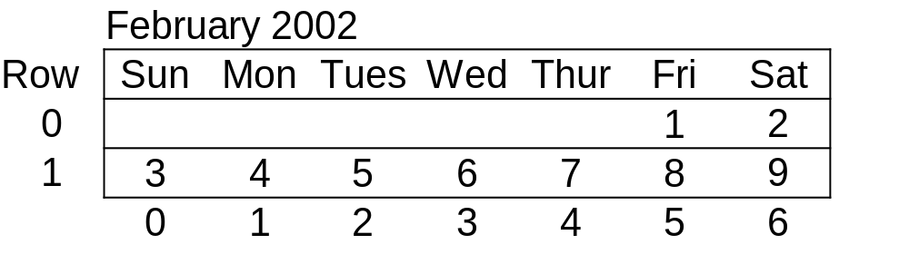
Example
If however, all the data is the same, a multi-dimensional array is appropriate. Say for example I want an array to represent a calendar.

Slide 37
// Feb 2002 spans 5 weeks with 7 days/week.
const int WEEKS = 5, DAYS = 7, MAX = 28;
int feb[WEEKS][DAYS];
int first = 5, today = 1, w, d;
for (w = 0; w < WEEKS; w++) {
  for (d=first; d < DAYS && today <= MAX; d++)
  {
    feb[w][d] = today;
    today++;
  }
  first = 0; // start back at Sunday
}

Slide 38
Remember we had the following:
// Feb 2002 spans 5 weeks with 7 days/week.
const int WEEKS = 5, DAYS = 7, MAX = 28;
int feb[WEEKS][DAYS];
If I have the following prototype for a function how do I call it using the feb array?
display_calendar(int c[][DAYS]);
If I have a function that prints a day number with the following prototype how do I call it for feb[2][3];
display_day(int day]);

Slide 39
Demo
matrix.cpp

Slide 40
Hands-On Arrays
Player Stats
  player.cpp contains part of a program to produce player stats.
  play.txt contains an input file
When you create a sample program you typically have to simplify the problem. If this were a real player stats program what would you do differently?

Slide 41
Arrays of the string object
If I define:
    string clue[4];
    display_clue(string s[]);
I can access the first character of the first string of clue with:
  clue[0].at(0); OR
  clue[0][0];
  To call display clue what should I do?

Slide 42
Arrays of the string object
If I define:
    string clue[4];
    clue_cards[3][4];
    display_clue(string s[]);
I can access the first character of the first string of the first card with:
  clue[0][0].at(0); OR
  clue[0][0][0];
  To call display clue for the first clue what should I do?

Slide 43
Demo 1
Accessing arrays of strings:
  clue.cpp

Slide 44
Demo 2
If I have an email address and how do I parse out the the words between the periods?
parse.cpp

Slide 45
Review
What are four real-world analogies for multi-dimensional arrays?
  A plastic storage box for screws; each drawer has little boxes. An example 3 dimensional array – drawers + rows + columns.
It was a dark and stormy night...
  What bad things can we do with
    strings
    cstrings?
What situation that would require a three-dimensional array? A four-dimensional array? 5?

Slide 46
Review 2
Write a cstring definition for a pocket translator. It can store a single phrase up to 20 characters long. Don't forget '\0'.
Write an array of cstrings for a more complicated translator. It can store three phrases up to 40 characters long.
Write a segment of C++ code that would display all the phrases for your array in #2.
Create the string version of number 2.
Write a segment of C++ code that displays your strings from #4.

Slide 47
Have we met the learning objectives?
Can you?
Use traditional C Strings and avoid the pitfall
Use the C++ Class string
Use Multidimensional Arrays
Define porting and fix a simple Borland->VC++ port?
Do you?
Know the common standard string functions
Understand how the communicative property effects operator precedence.

Slide 48
Home Study
Be able to answer all self test exercises in Chapter 10
Be able to define or understand the issue highlighted for terms in Chapter 10
Read Chapter 11
Create pseudocode for Lab 1.

Slide 49
Today's Index card
For 5 points:
  Front => Three important points from this class
  Back =>
    One thing you think I should review next time.
    What one thing can you do this week to reinforce your learning about arrays.

